Slide 1
Web Application Development With Java CEJV 559
JSF Concepts

Slide 2
JavaServer Faces Application
A set of web pages in which components are laid out.
A set of tags to add components to the web page.
A set of managed beans
lightweight, container-managed objects
managed beans serve as backing beans that define properties and functions for UI components on a page
A web deployment descriptor (web.xml file).

Slide 3
JavaServer Faces Application
One or more application configuration resource files
faces-config.xml file
used to define page navigation rules and configure beans and other custom objects, such as custom components
a set of custom objects

Slide 4
JavaServer Faces Application
OPTIONALLY:
Custom components
Validators
Converters
Listeners
Set of custom tags for representing custom objects on the page

Slide 5
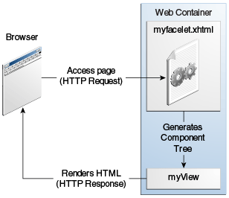
Responding to a Client Request for a JavaServer Faces Page

Slide 6
JSF Framework Services

Slide 7
JSF Framework Services
Responsible for interacting with client devices
Ties together the visual presentation, application logic, and business logic of a web application
Scope of JSF is restricted to the presentation tier
Database persistence, web services, and other backend connections are outside the scope of JSF

Slide 8
JSF Framework Services
Model-view-controller architecture
Data conversion
Validation and error handling
Internationalization
Custom components
Ajax support
Alternative renderers

Slide 9
Component Tree
Initializes the JSF code and reads the index.xhtml page
Page contains tags, such as h:form and h:inputText
Each tag has an associated tag handler class
Tag handlers are executed when the page is read
Tag handlers collaborate with each other to build a component tree
Data structure that contains Java objects for all user interface elements on the JSF page

Slide 10
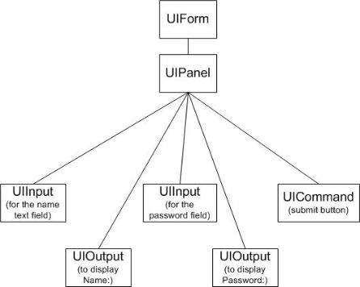
Component Tree

Slide 11
Rendering Pages
Once the tree is complete the page is rendered in HTML
Text that is not a JSF tag is passed through
h:form, h:inputText, h:inputSecret, and h:commandButton tags are converted to HTML
Each tag gives represents a component
Each component has a renderer that produces HTML output that reflects the component state

Slide 12
Rendering Pages
Renderer for the component for the h:inputText tag produces the following output:
<input type="text" name="unique ID"
value="current value"/>
Process is called encoding
Renderer of the UIInput object asks the JSF to look up the unique ID and the value of the expression user.name
ID strings are assigned by the JSF implementation
IDs can look random, such as _id_id12:_id_id21.
Encoded page is sent to the browser

Slide 13
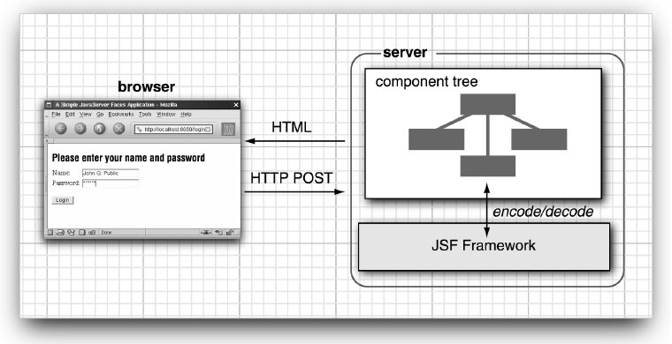
Encoding and Decoding JSF Pages

Slide 14
Decoding Requests
User fills in the form fields and clicks the login button
Browser sends the form data back formatted as a POST request
POST request contains the URL of the form (/login/faces/index.xhtml), as well as the form data
Data is a string of ID/value pairs, such as:
id1=me&id2=secret&id3=Login

Slide 15
Decoding Requests
Each component can inspect the form data in a process called decoding
Login form has three component objects:
two UIInput objects that correspond to the text fields on the form
one UICommand object that corresponds to the submit button
UIInput components update the bean properties referenced in the value Attributes
invoke the setter methods with the values that the user supplied.

Slide 16
Decoding Requests
UICommand component checks whether the button was clicked
Fires an action event to launch the login action referenced in the action attribute.
Event tells the navigation handler to look up the successor page, welcome.xhtml.
Cycle repeats

Slide 17
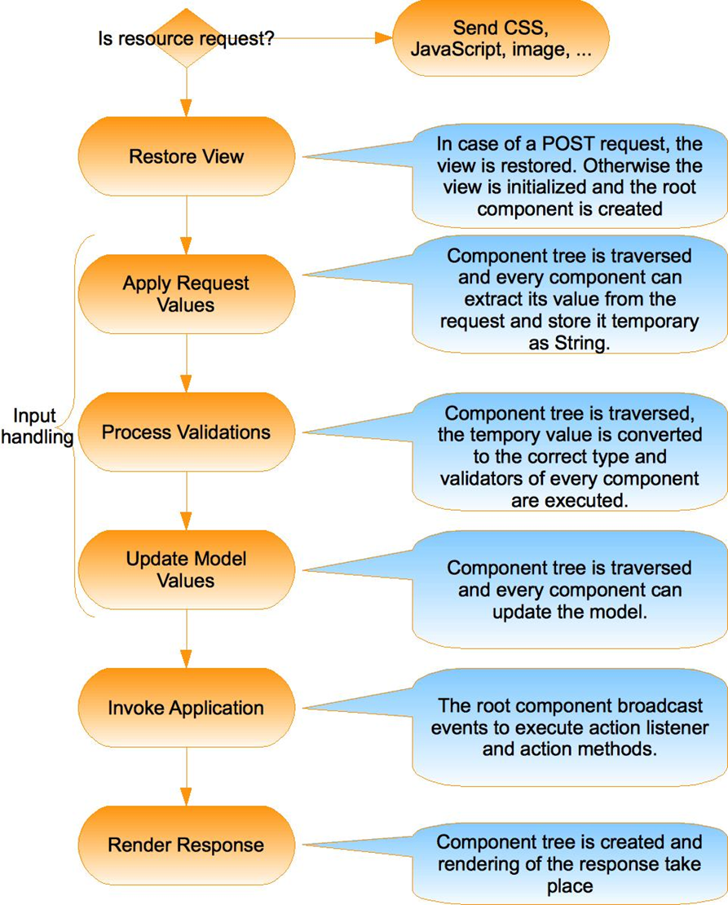
JSF Standard Request-Response Life Cycle
Handles two kinds of requests:
Initial requests
occurs when a user makes a request for a page for the first time
Postbacks
occurs when a user submits the form contained on a page that was previously loaded into the browser as a result of executing an initial request

Slide 18
JSF Standard Request-Response Life Cycle
Restore View Phase
Apply Request Values Phase
Process Validations Phase
Update Model Values Phase
Invoke Application Phase
Render Response Phase

Slide 19
Restore View
Phase that retrieves the component tree for the requested page
constructs a new component tree if it is displayed for the first time.
uses a an existing tree if it was displayed previously
If there are no request values, skips ahead to the Render Response phase.
Happens when a page is displayed for the first time.

Slide 20
Apply Request View
JSF implementation iterates over the component objects in the component tree
Each component object checks which request values belong to it and stores them

Slide 21
Process Validations
Values stored in the component are called “local values”.
Validators/converters can be attached that perform correctness checks on the local values
If validation passes, the JSF life cycle proceeds normally
Otherwise the JSF implementation invokes the Render Response phase directly
current page is redisplayed so that the user has another chance to provide correct inputs.

Slide 22
Update Model Values
Local values are used to update the beans that are wired to the components

Slide 23
Invoke Application
Handles any application-level events such as:
Action method of the button or link component is executed
Can carry out arbitrary application processing
Returns an outcome string that is passed to the navigation handler
Navigation handler looks up the next page

Slide 24
Render Response
Builds the view and delegates authority to the appropriate resource for rendering the pages
Encodes the response and sends it to the browser
If the request is a postback and errors were encountered during the Apply Request Values phase, Process Validations phase, or Update Model Values phase, the original page is rendered again during this phase

Slide 25
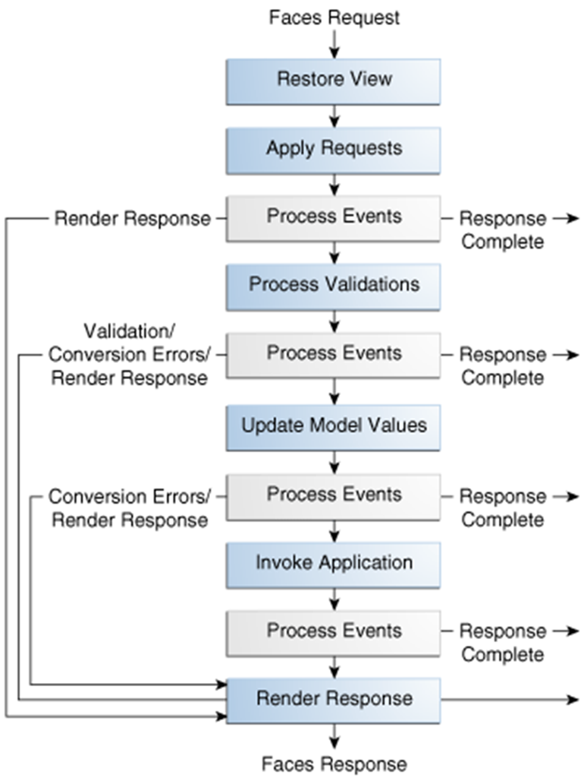

Slide 26
Bibliography
http://docs.oracle.com/javaee/7/tutorial/jsf-intro.htm

